Slide 1

Carbon Dioxide Plume Detection & Characterization With The Orbiting Carbon Observatory 2 (OCO2)
Liev Birman
The University of Wisconsin – Madison
Rising Junior – Physics
July 29, 2015

Slide 2
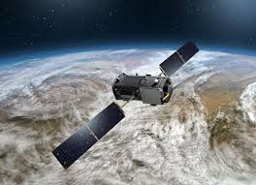
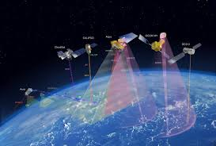
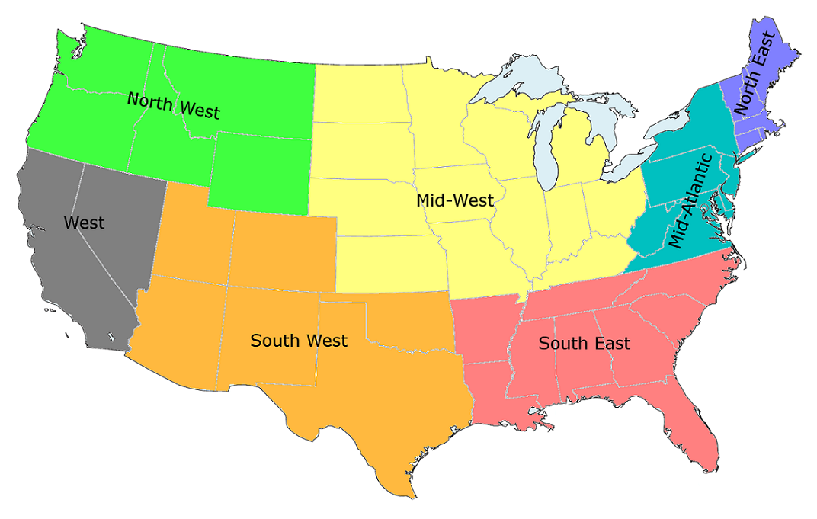
What is the Orbiting Carbon Observatory 2?
A remote sensing instrument that measures the total column average of Carbon Dioxide in the atmosphere.
1st NASA mission dedicated to Carbon Dioxide.
Exploratory mission to characterize Carbon Dioxide sources and sinks at regional scales.
Validation for future space based missions (OCO3).

Slide 3
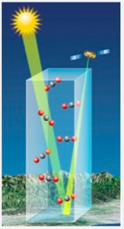
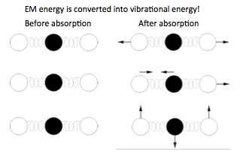


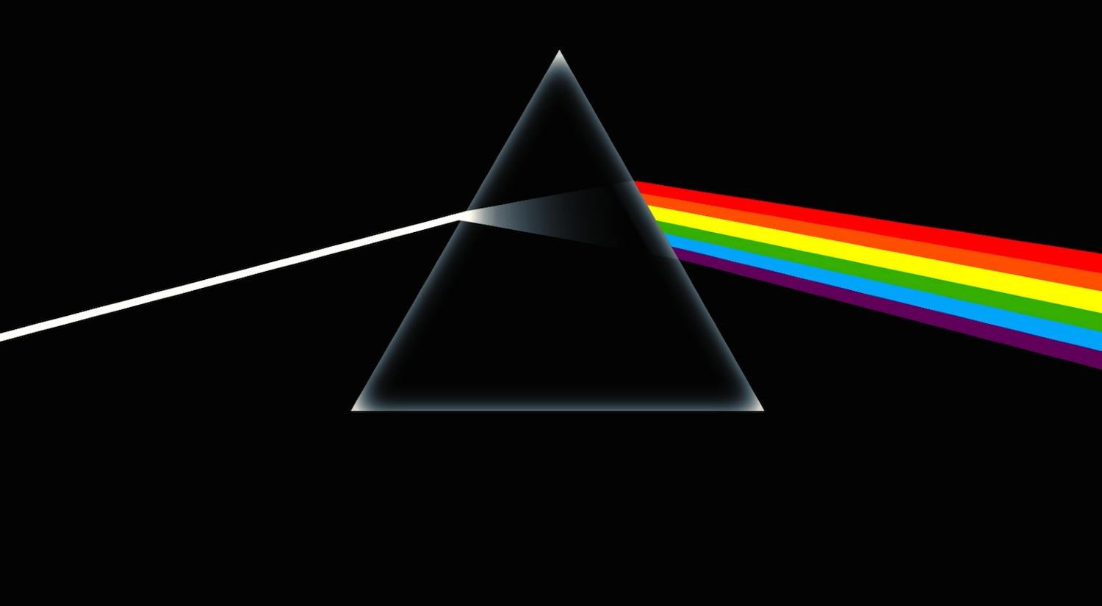


How does OCO-2 measure Carbon Dioxide?
Why the two carbon dioxide bands?
The vibrational frequencies of carbon dioxide are pressure dependent and thus altitude dependent.
Why the oxygen band?
Oxygen concentrations are well known and are used to determine the amount of air that the light has passed through before reaching OCO2.
2.06 micron
1.61 micron
0.765 micron

Slide 4
Detecting Plumes
Approach
Threshold Search
Peak Detection
3. Plume Model Fit
Project Goals
Test the method.
Validate against WRF model.
3. Provide detection tool to Project Scientist

Slide 5

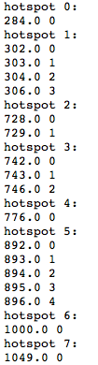
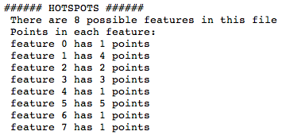
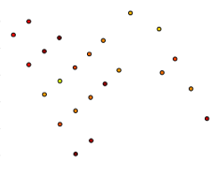
Threshold Search

Slide 6
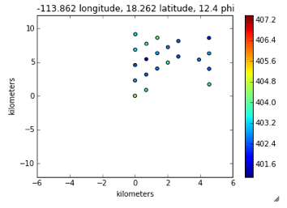
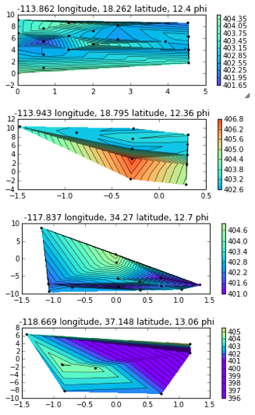
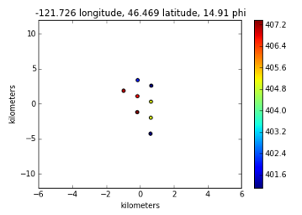
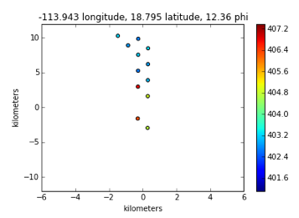
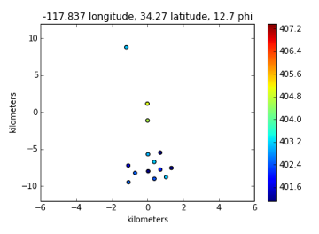
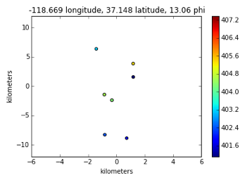
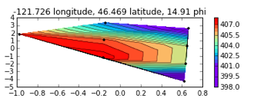
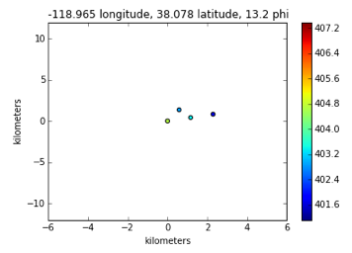
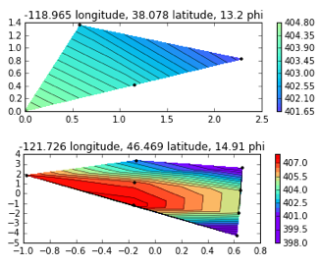
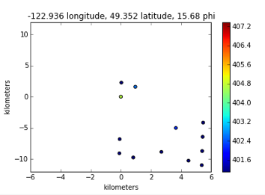
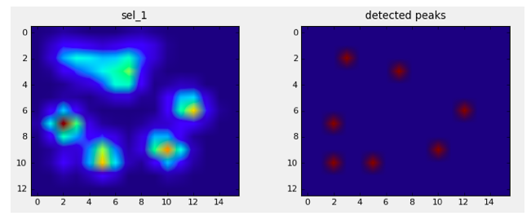
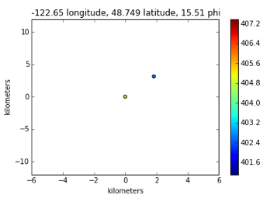
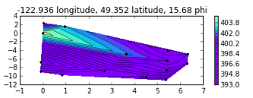
Peak Detection

Slide 7
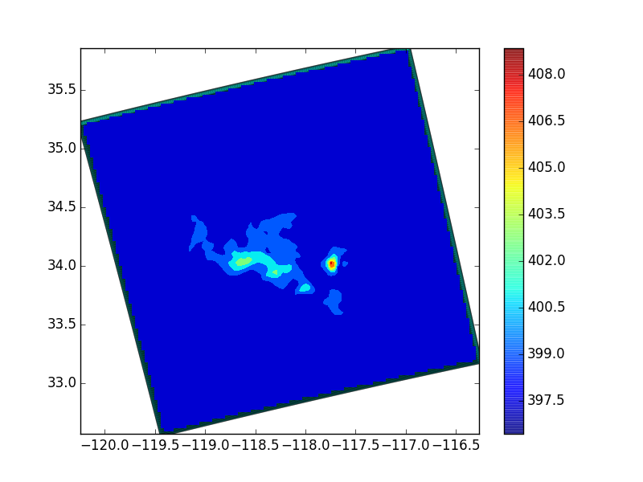
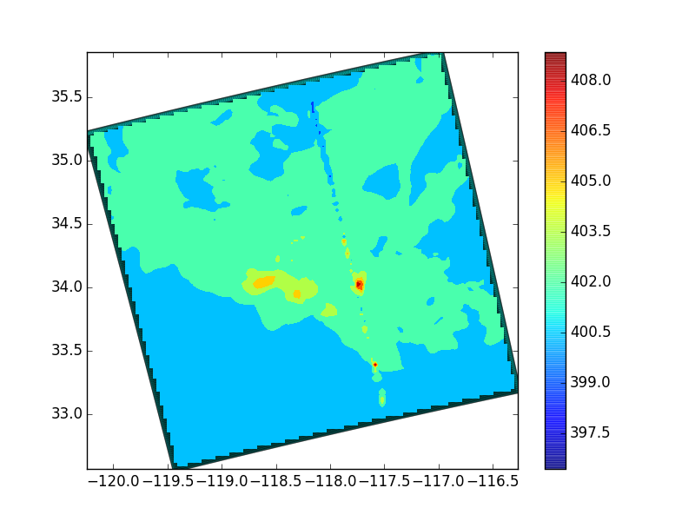
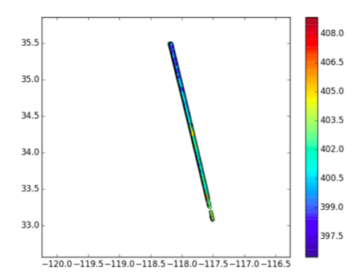
Attempt at WRF comparison
+
=

Slide 8
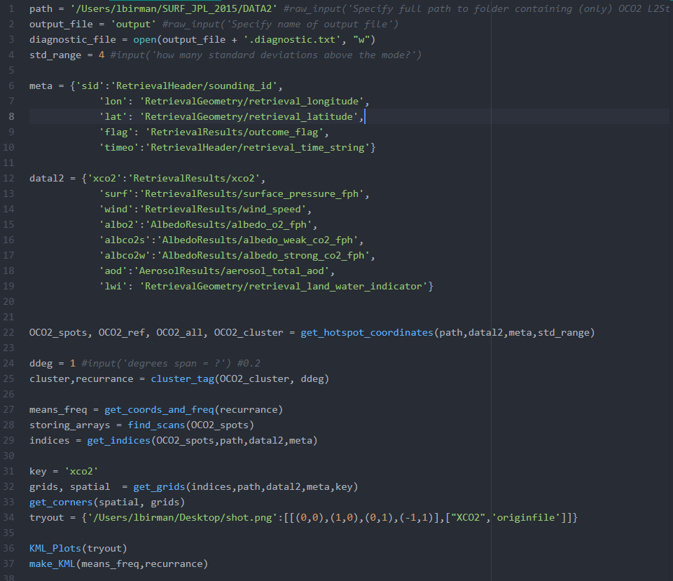
Plume Detection Python Module
1: Specify path to folder with all files
2: Specify name of output file
3: Specify name of diagnostic file
4: Specify Standard Deviation range for hotspot search
6 & 12: Specify data and paths to data
22: Get hotspots in a few useful data structures
24: Specify latitude degree range for a hotspot (a spatial cutoff)
25: Get cluster and file information for use one of the KMLs
27: Relate the high recurrence files to coordinates
28: Relates sounding IDs to their containing files
29: Necessary data handling function
31: Get grids and spatial information for each grid
33: Get corner coordinates
34: testing out a .kml plot
37: Making the recurrences KML

